Slide 1
Sustainability in Systems Design
Hardware & Energy Profiling of T5 Workloads
on Ada Generation Architecture
Raphael Dapalma
COMP 597 | McGill University

Slide 2
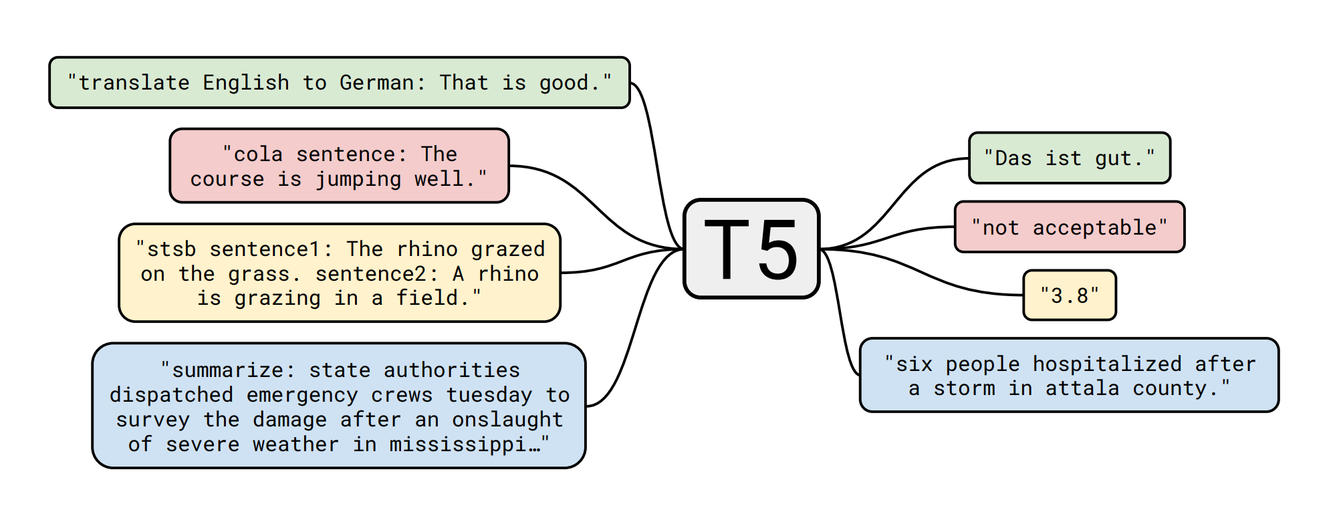
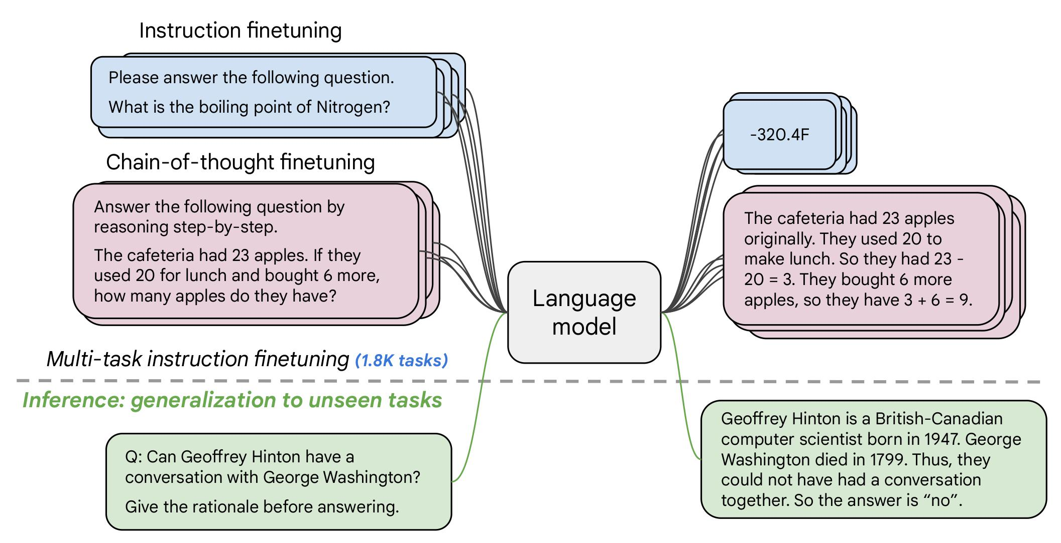
Workload: HuggingFace T5 (220M)
Unified “Text-to-Text” Architecture
Treats every NLP task uniformly
Hardware: NVIDIA RTX 5000 Ada (32GB VRAM, 250W TDP).
Synthetic Data: MilaBench in-memory dataset bypasses PCIe storage bottlenecks which guaranteed ~100% GPU compute saturation.

Slide 3
Profiling Methodology
3 x 3 Experimental Matrix: Batch Sizes (8,4,2) across 3 Repetitions.
Strictly bounded to 300-second execution windows.
Five Distinct Execution Modes per Repetition:
NOOP Baseline: Pure end-to-end execution
CodeCarbon: Software-level energy tracking baseline.
Fine-Grained Timeline: Non-blocking NVML polling (≥ 500 ms).
Phase Isolated: Forward, Backward, and Optimizer runs.
Forced I/O: Deliberate Checkpoint stalls
Filtered out the initial JIT Compilation spikes by discarding the first 6 warmup steps

Slide 4
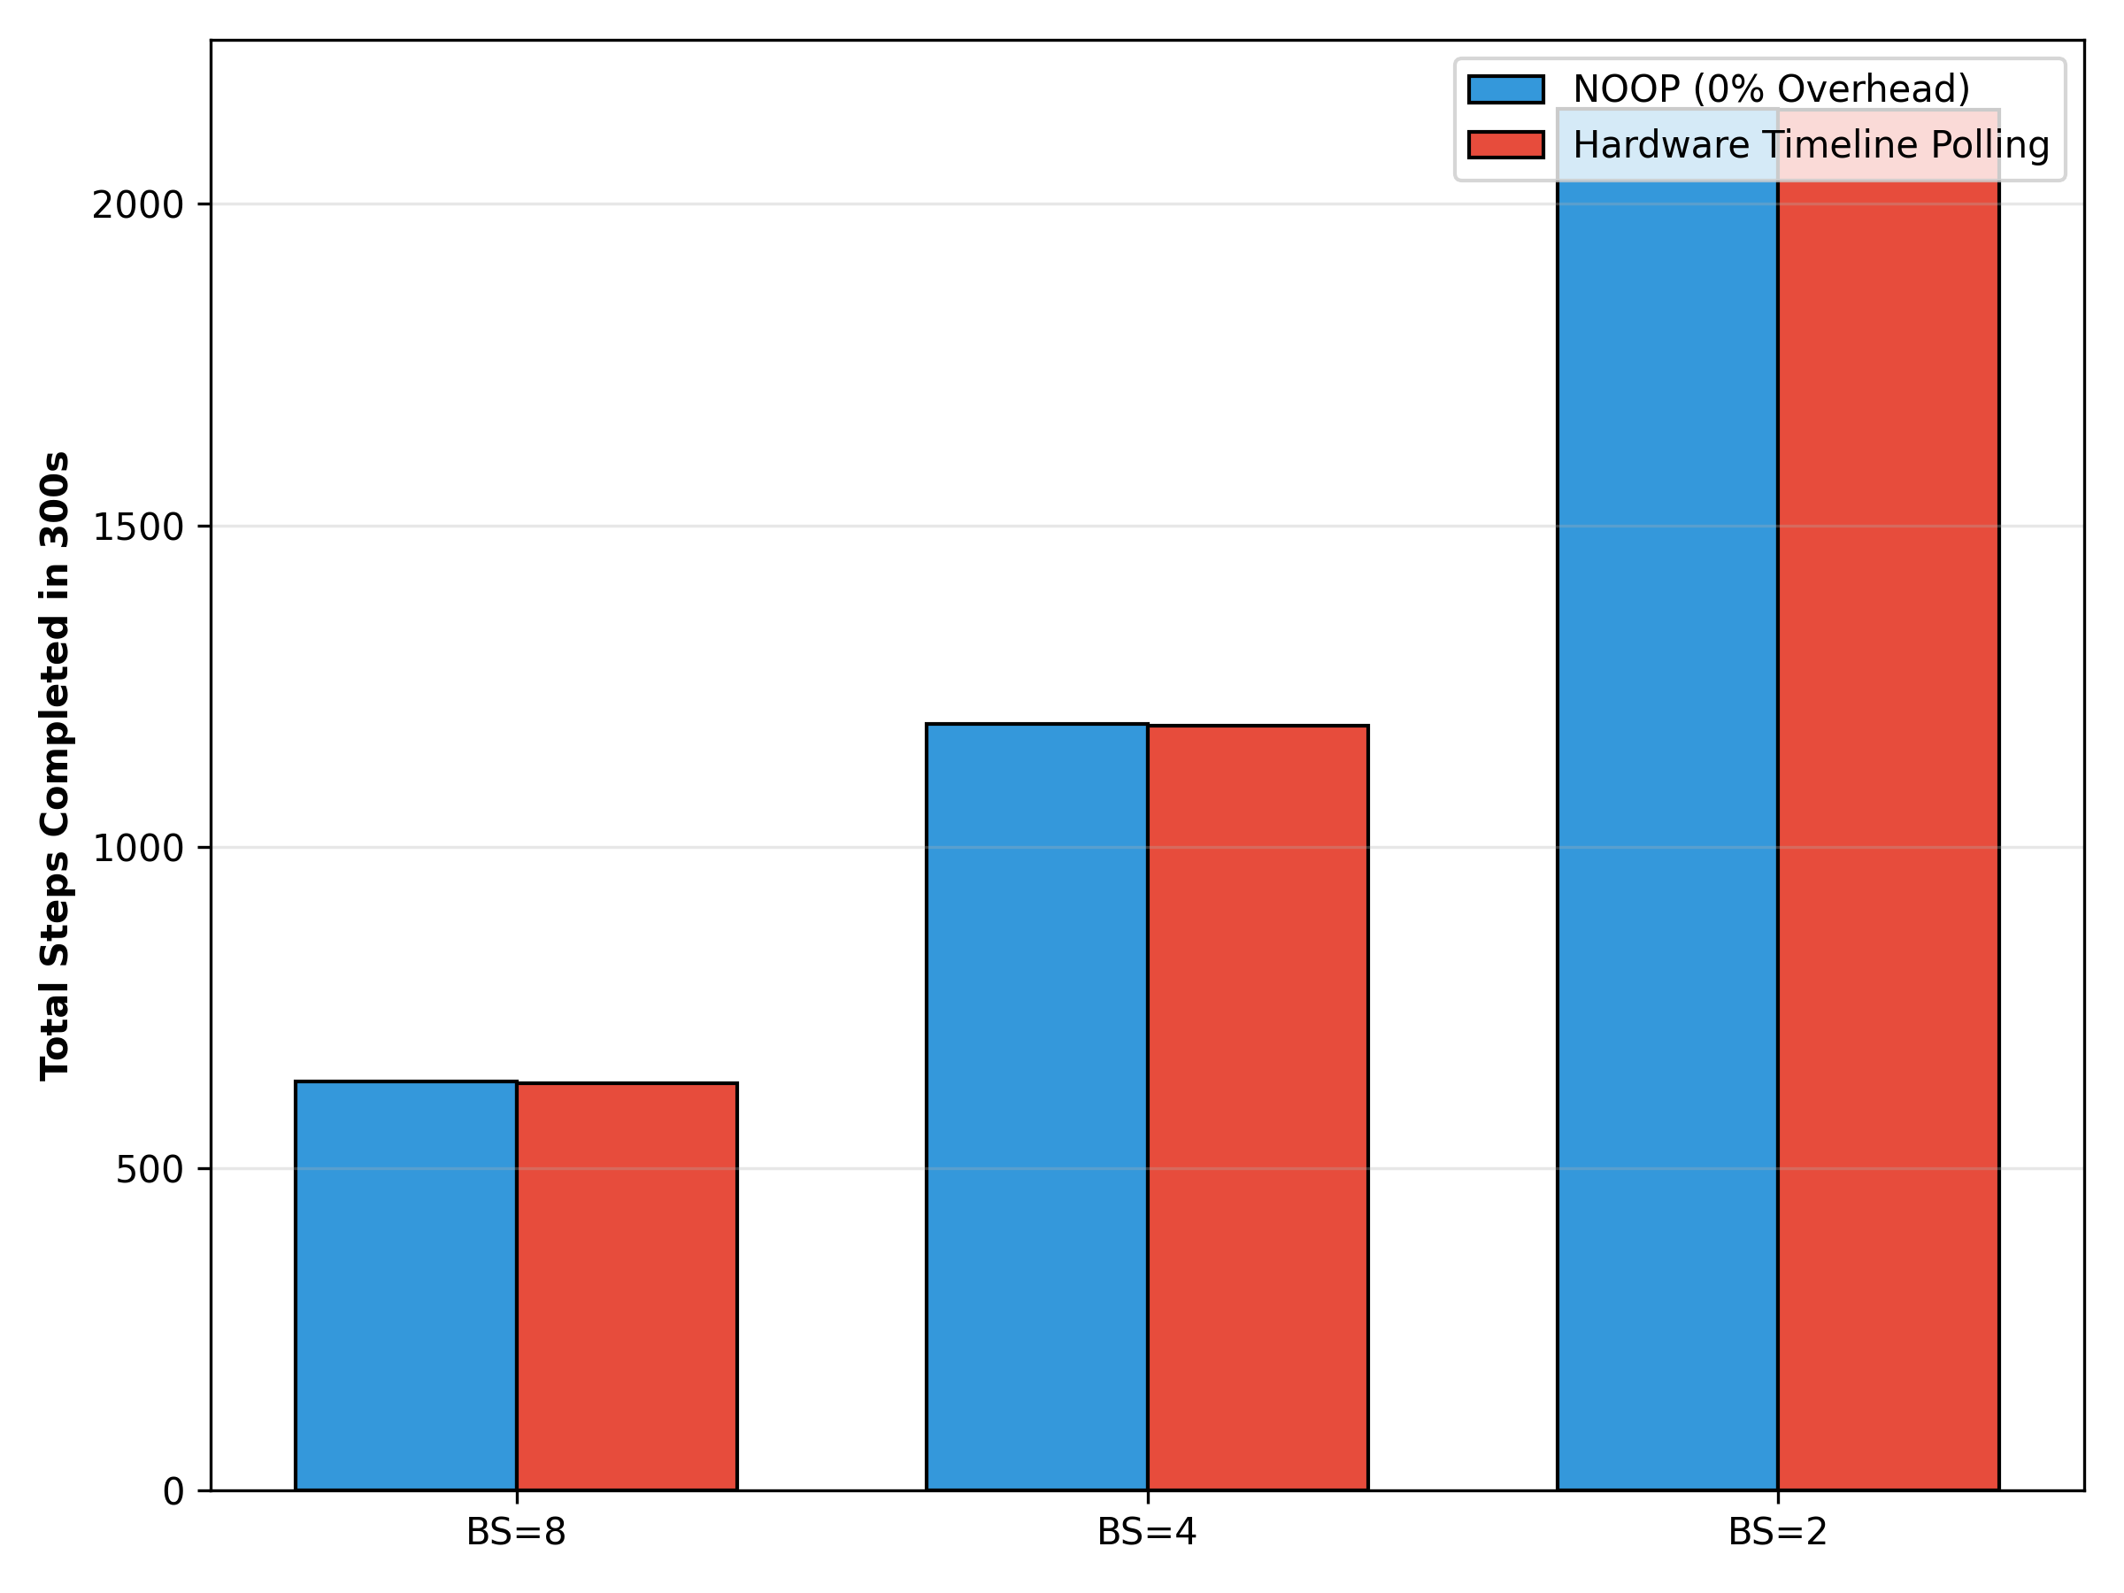
Defeating the Observer Effect
Phase-decoupled profiling eliminates pipeline-destroying
CUDA synchronization stalls, maintaining < 3% overhead.

Slide 5
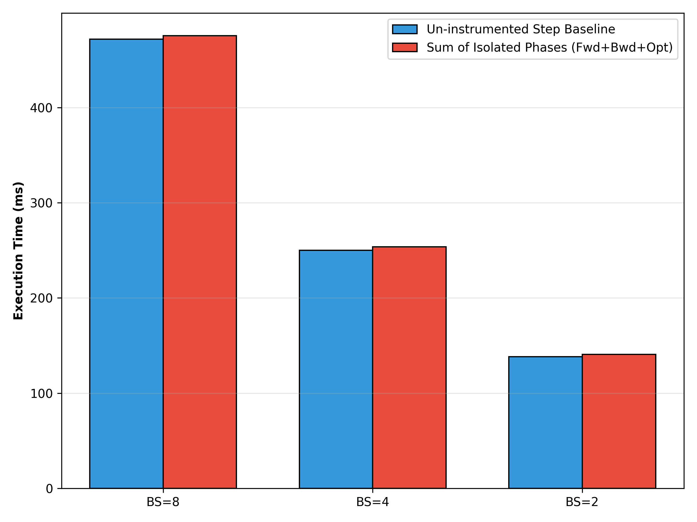
Validation: "Zero Dark Time"
Sum of independently isolated phases matches the un-instrumented baseline, proving no hidden PCIe/CPU starvation.

Slide 6
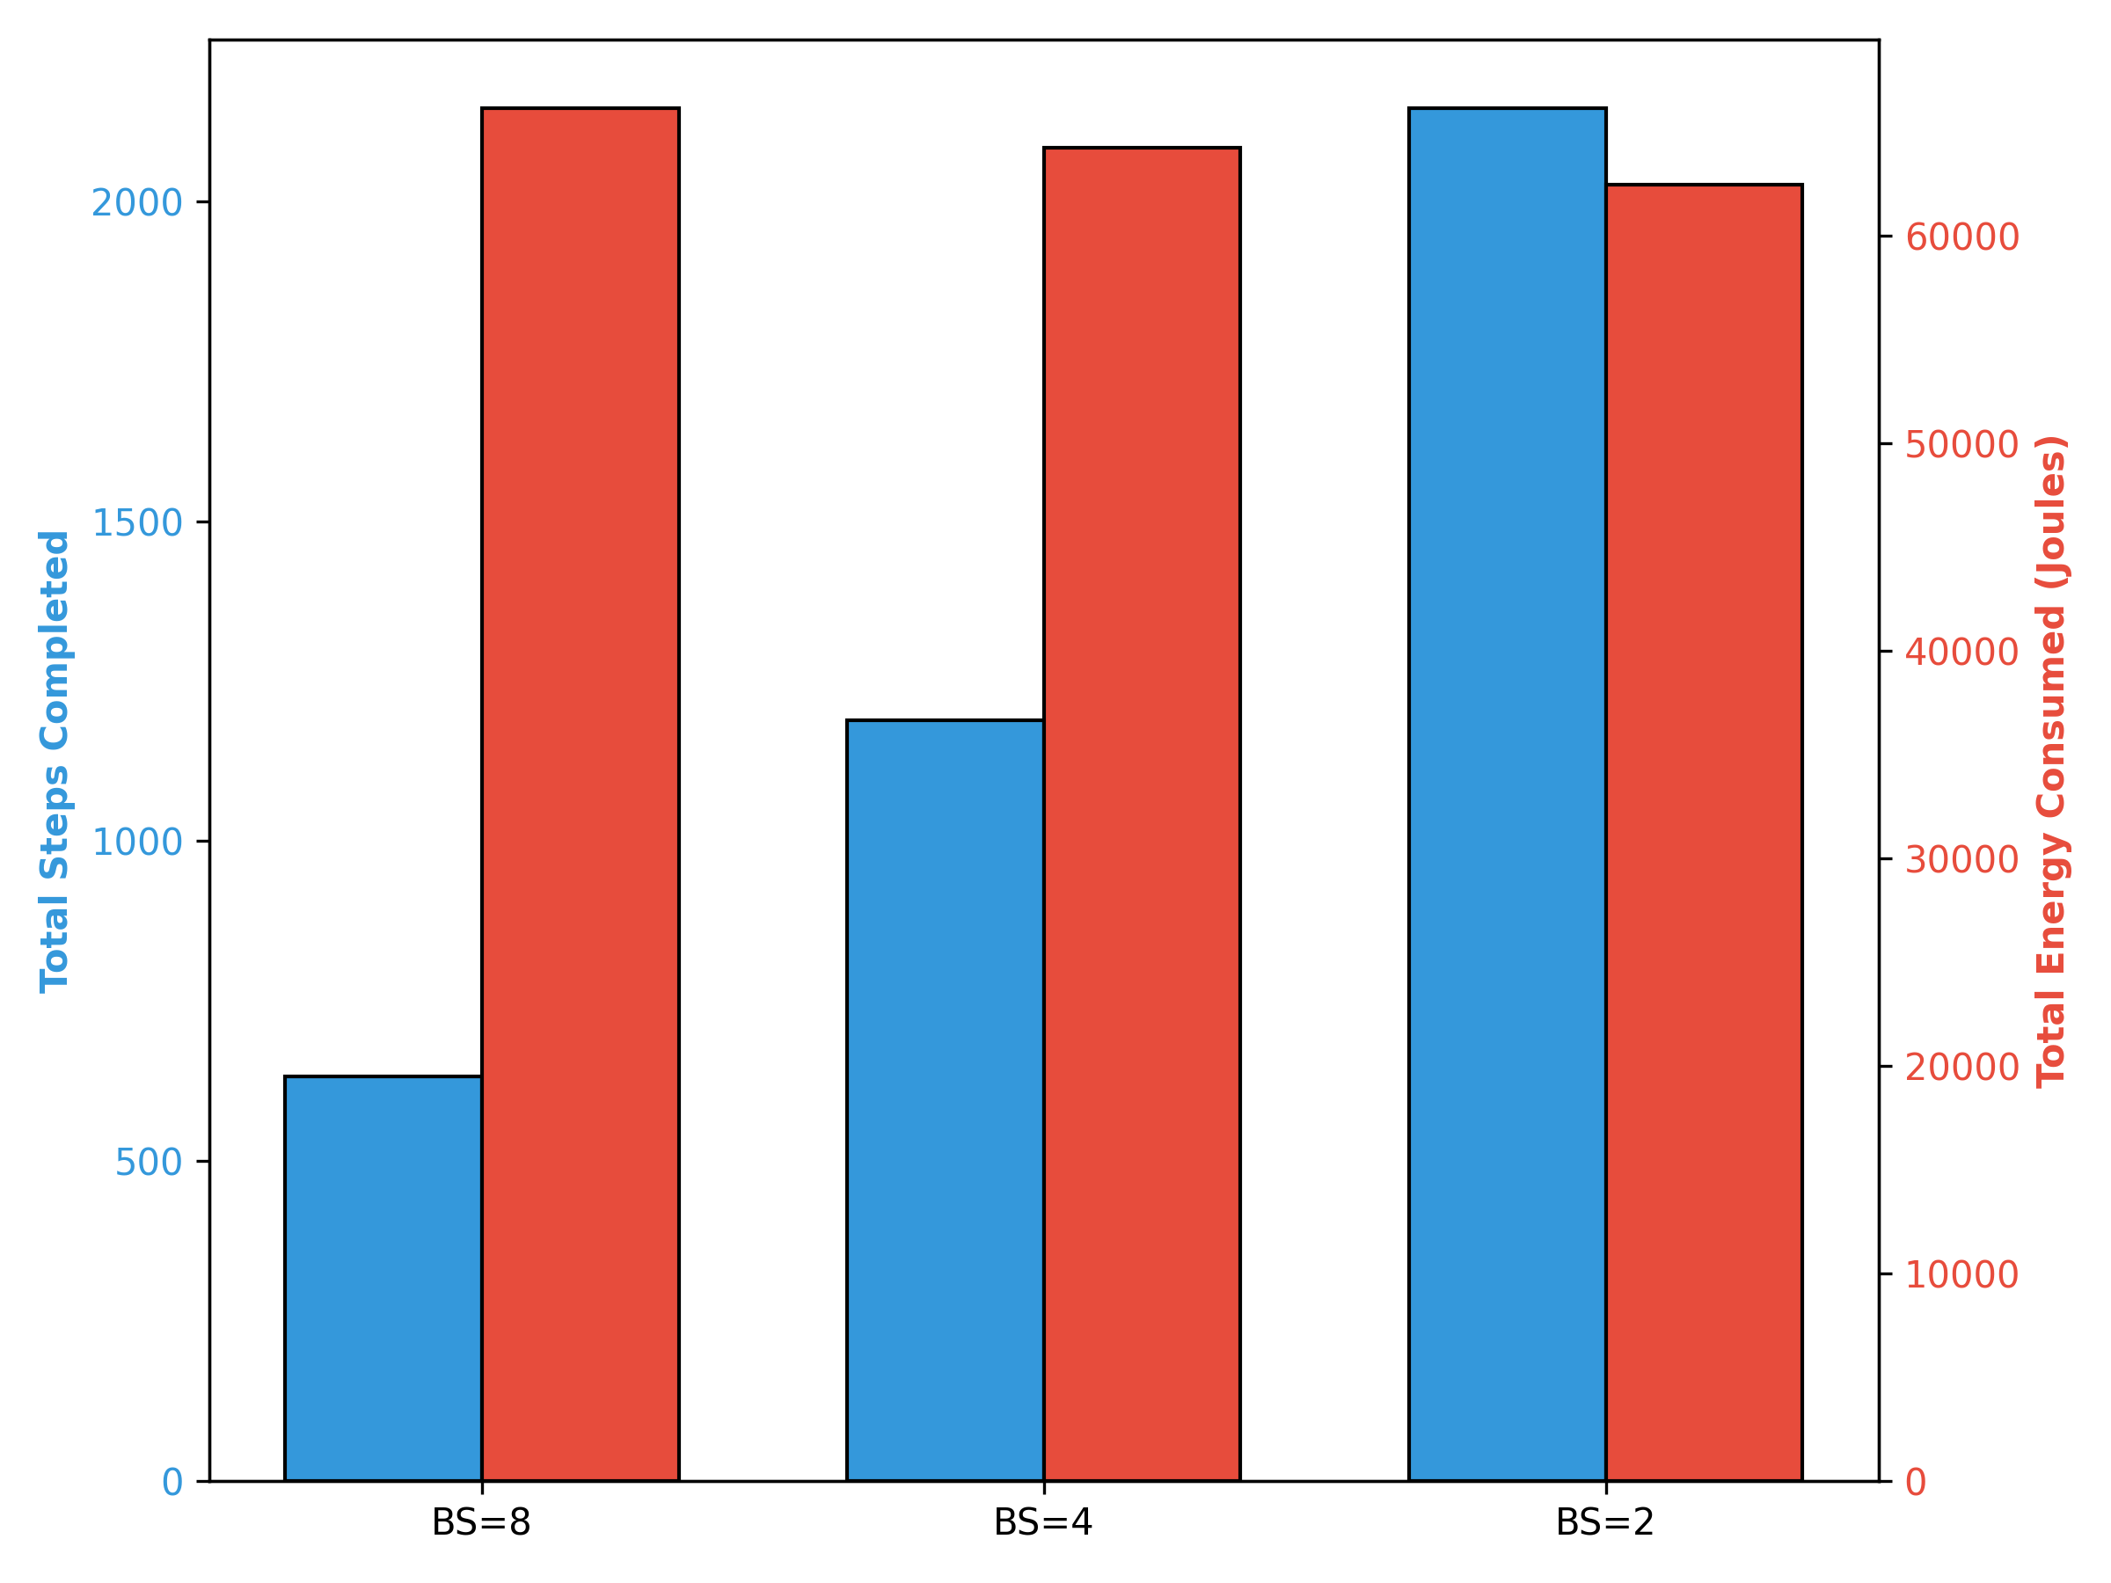
Results: Macro Throughput
TDP Ceiling: All configurations locked at ~64,000 Joules across 300s.
Step Scaling: Halving the batch size dramatically inflates total steps completed.
VRAM Limit: Batch Size 8 is the physical maximum due to 19GB backpropagation caching.

Slide 7
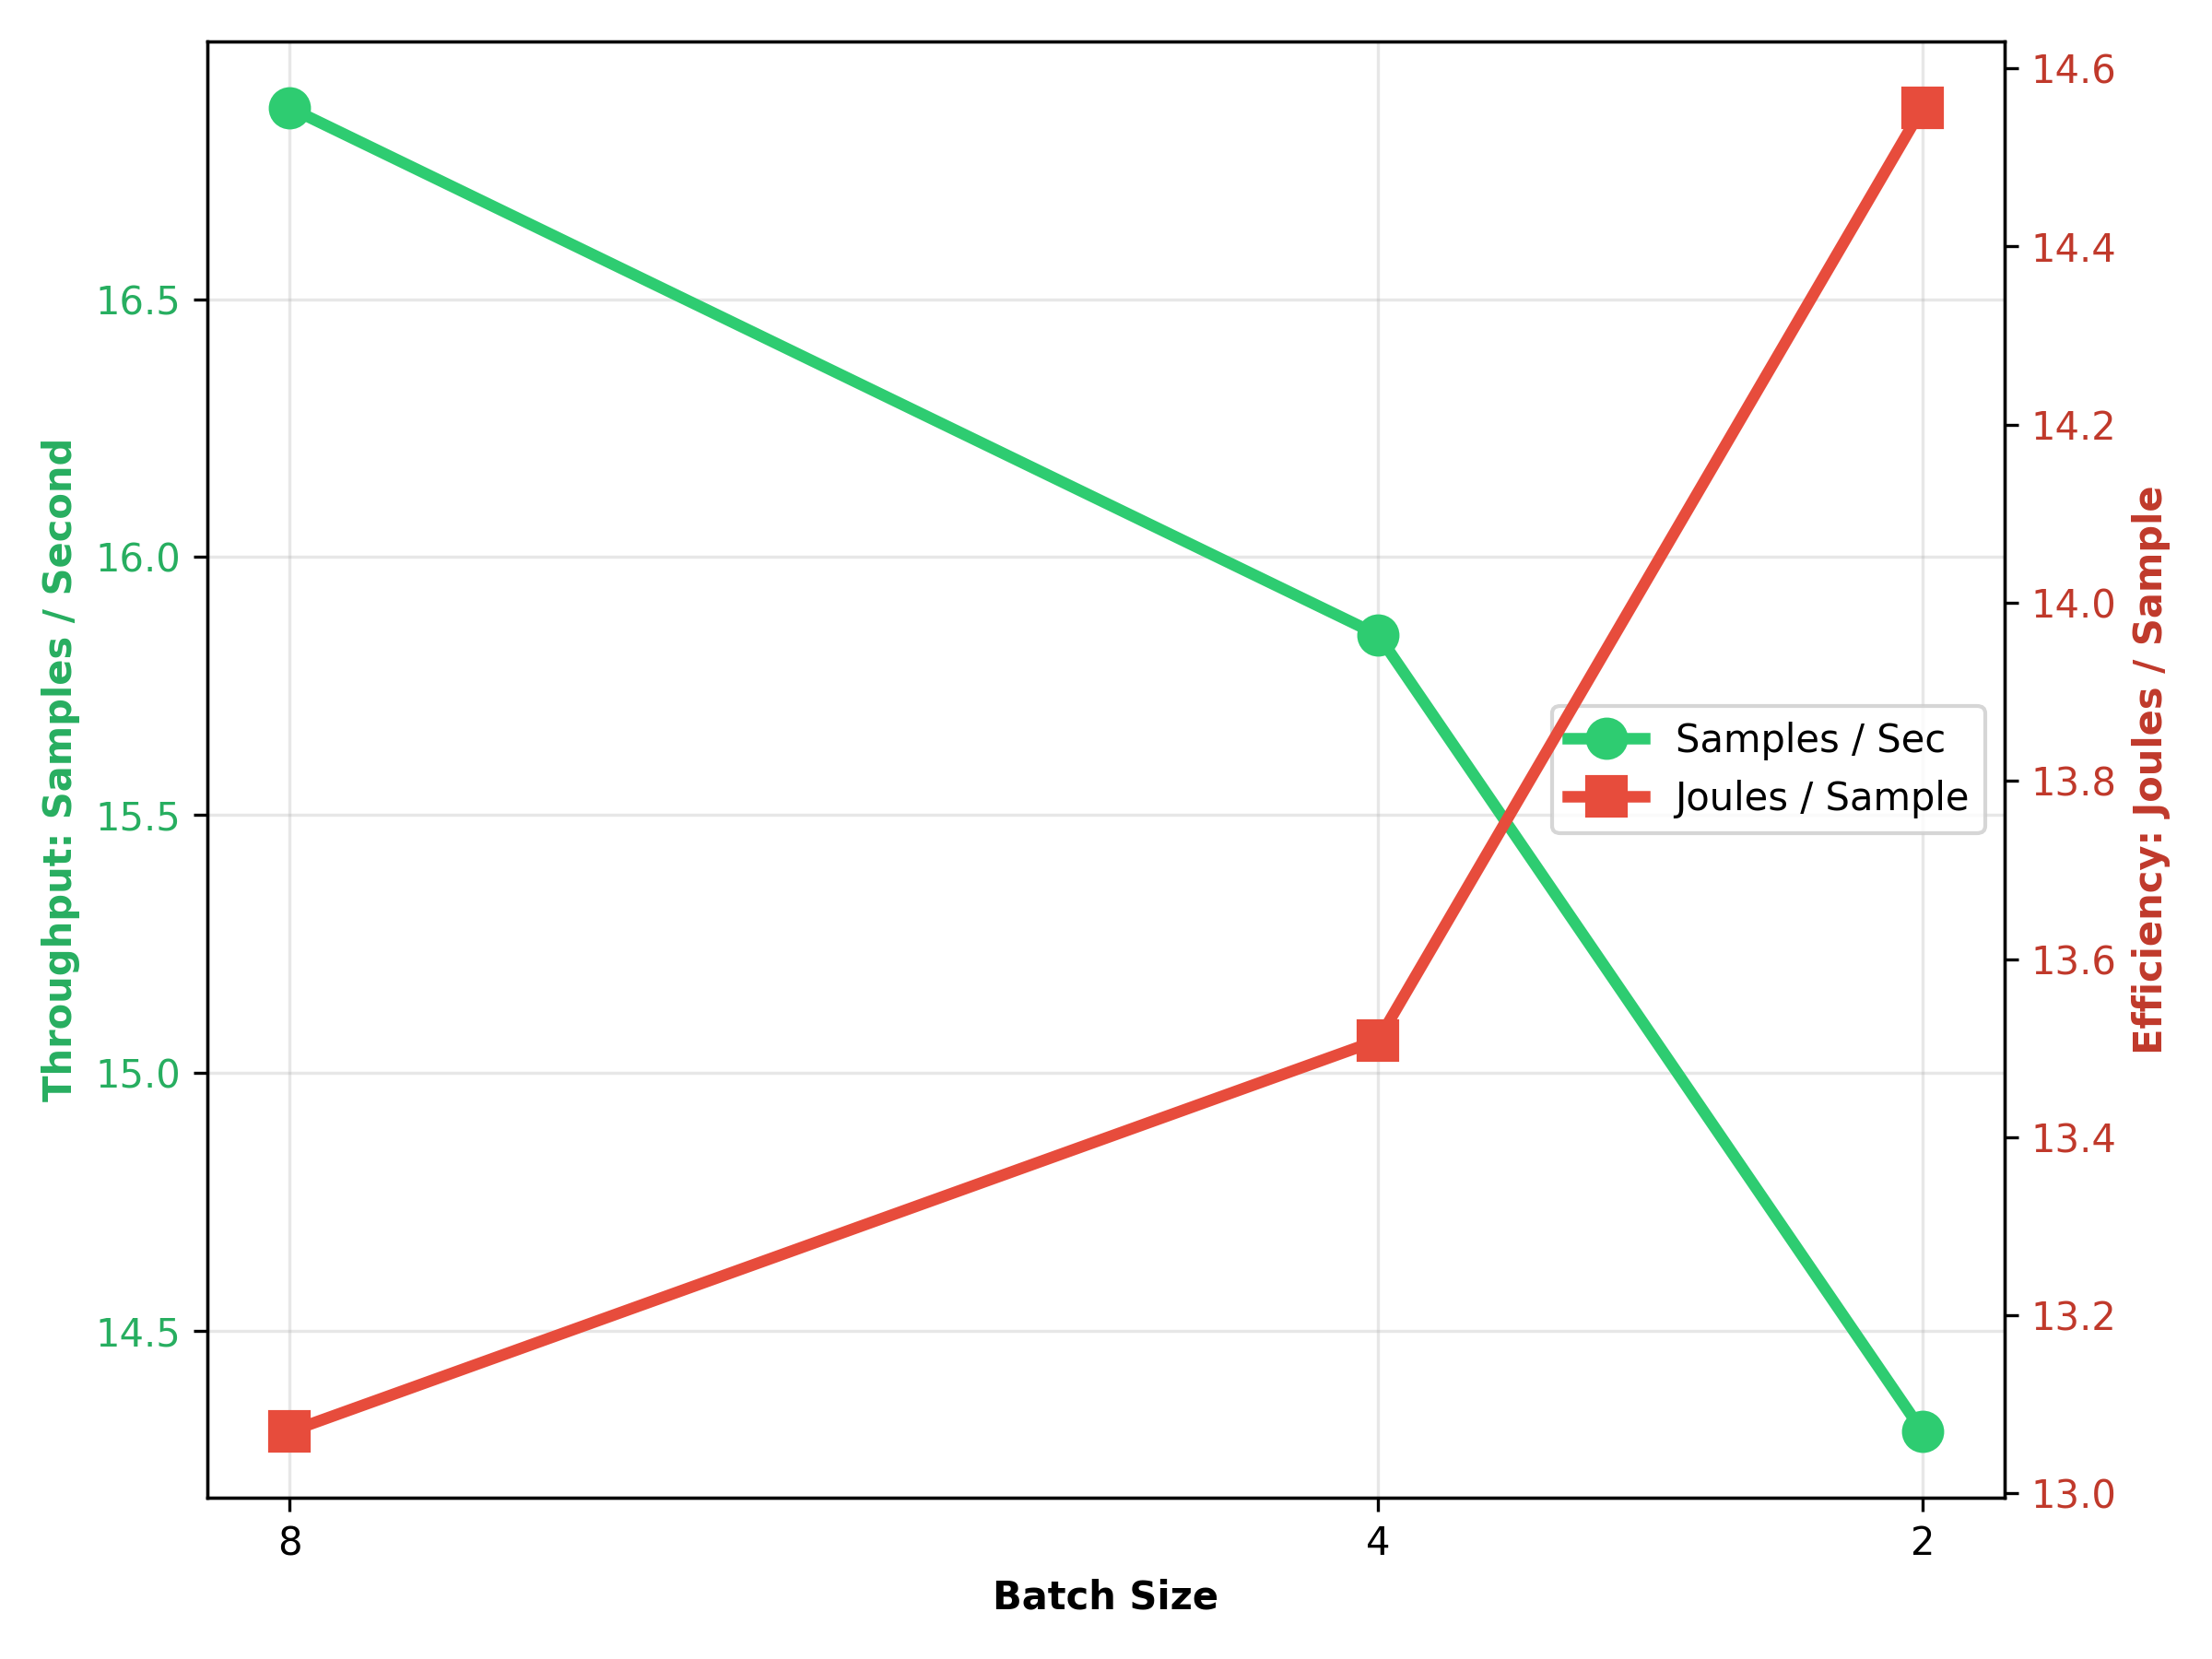
Results: Throughput vs. Efficiency
Larger batch sizes process more samples at a
significantly lower energy cost per sample.

Slide 8
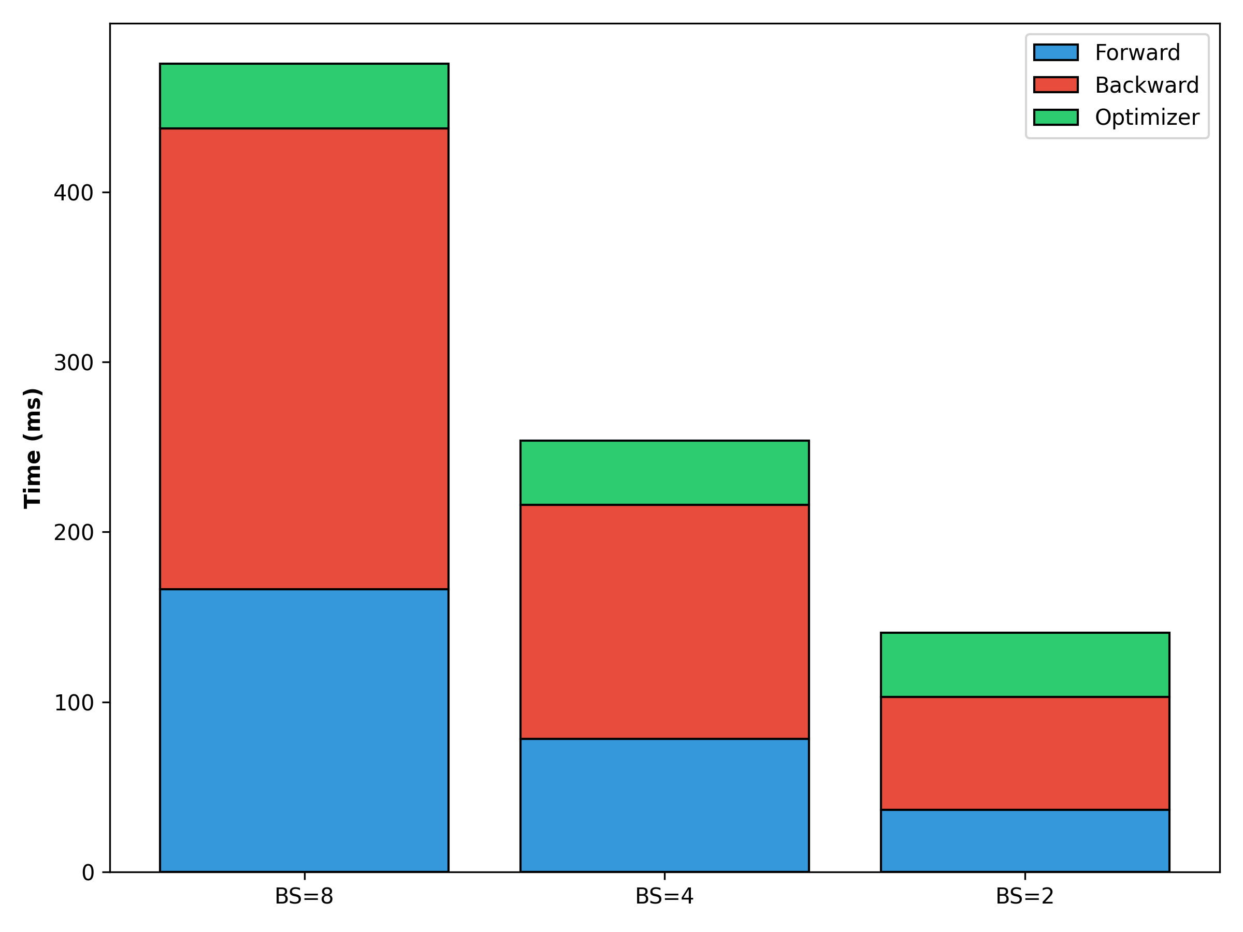
Bottleneck: O(1) Optimizer Penalty
Linear Scaling: Forward & Backward passes shrink proportionally with data volume.
Static Penalty: Optimizer stays locked at ~38ms.
Energy Waste: At BS=2, 28% of energy is wasted strictly on fixed-cost updates.

Slide 9
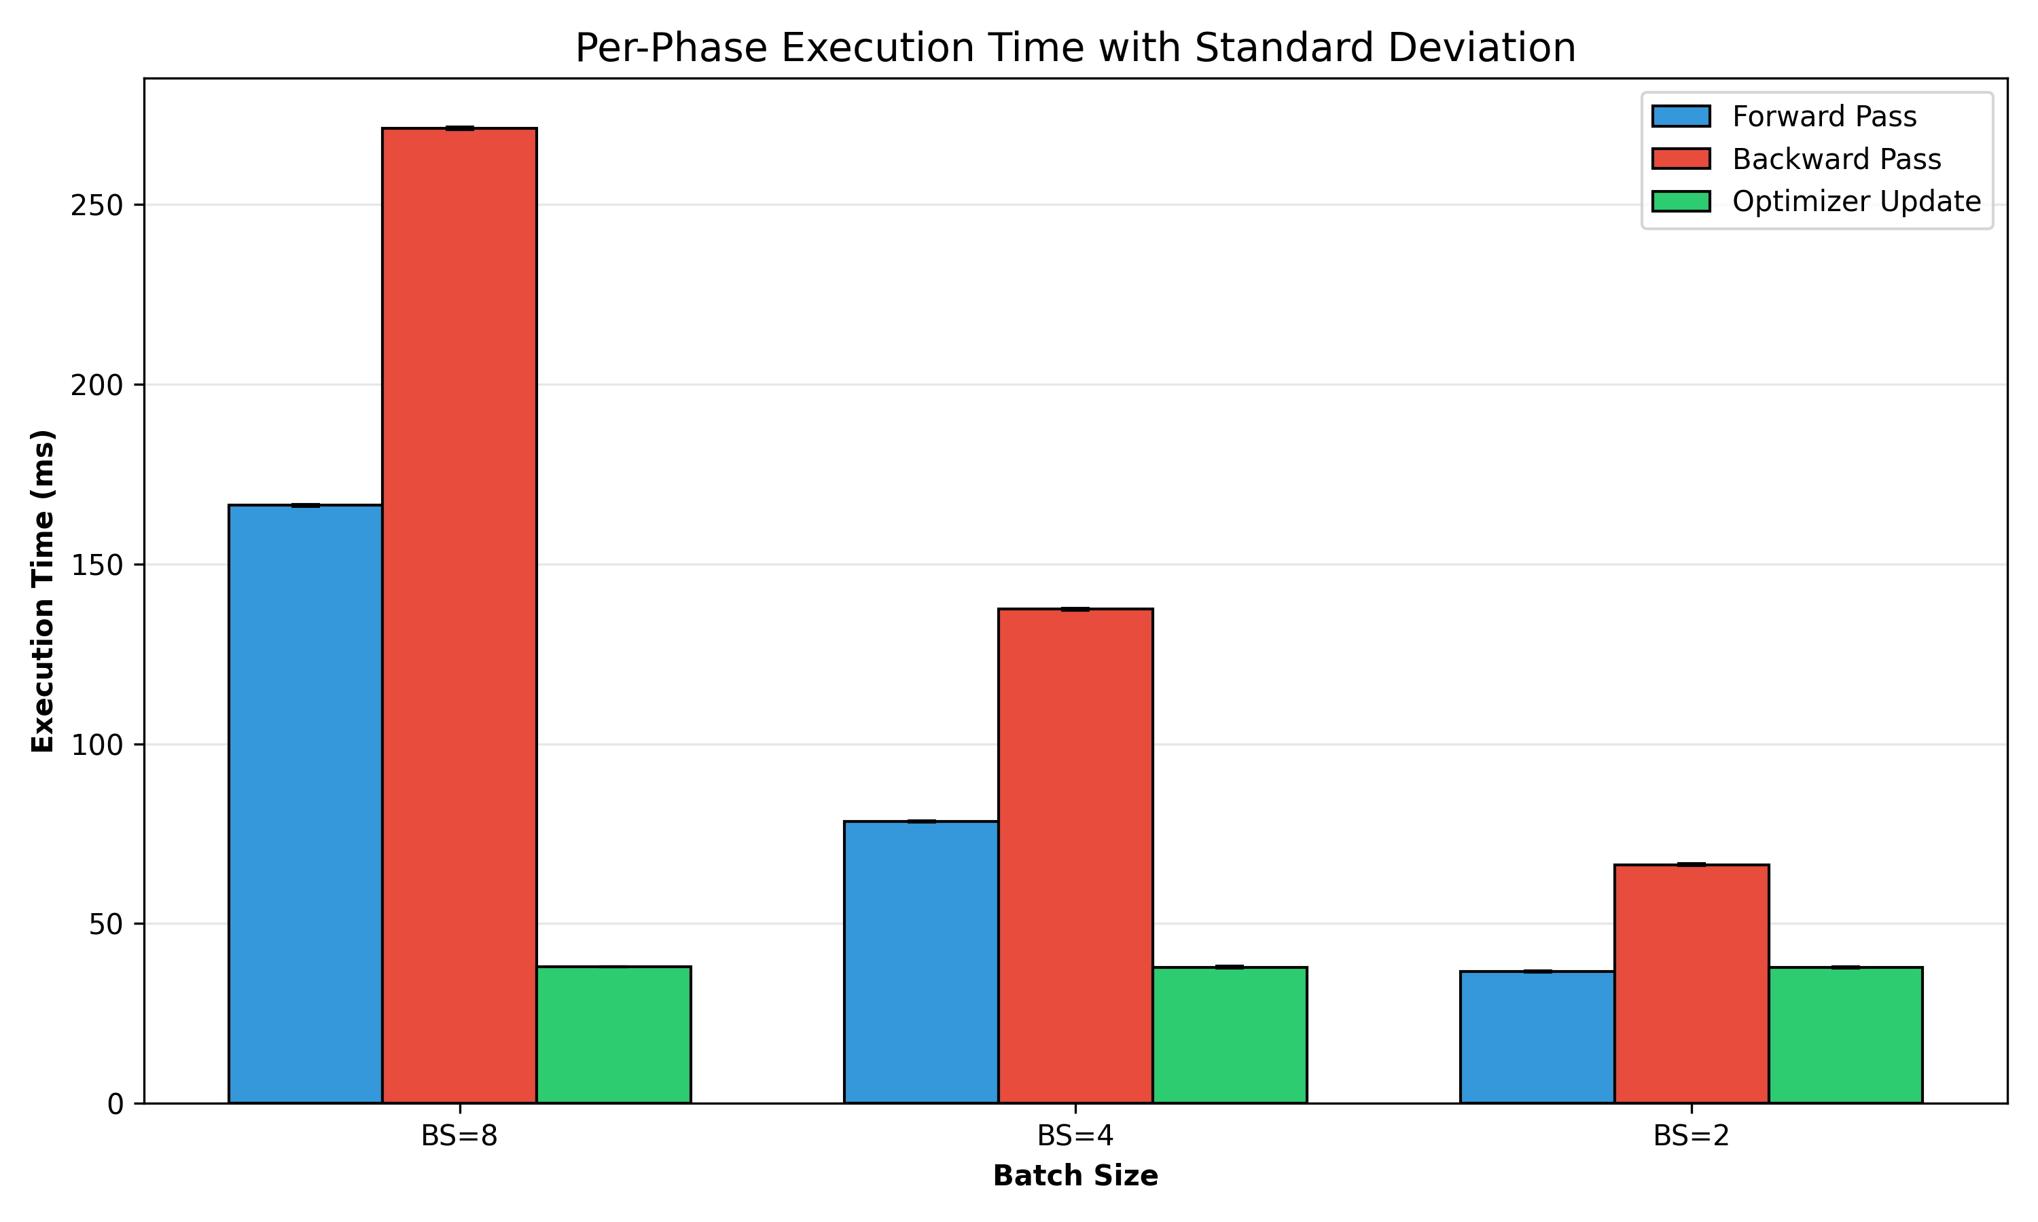
Measurement Precision & Stability
Tiny Variance: Error bars are practically imperceptible.
Warmup Filtering: Discarding JIT spikes isolates steady-state execution
Stable Thermodynamics: Proves we captured the true hardware baseline

Slide 10
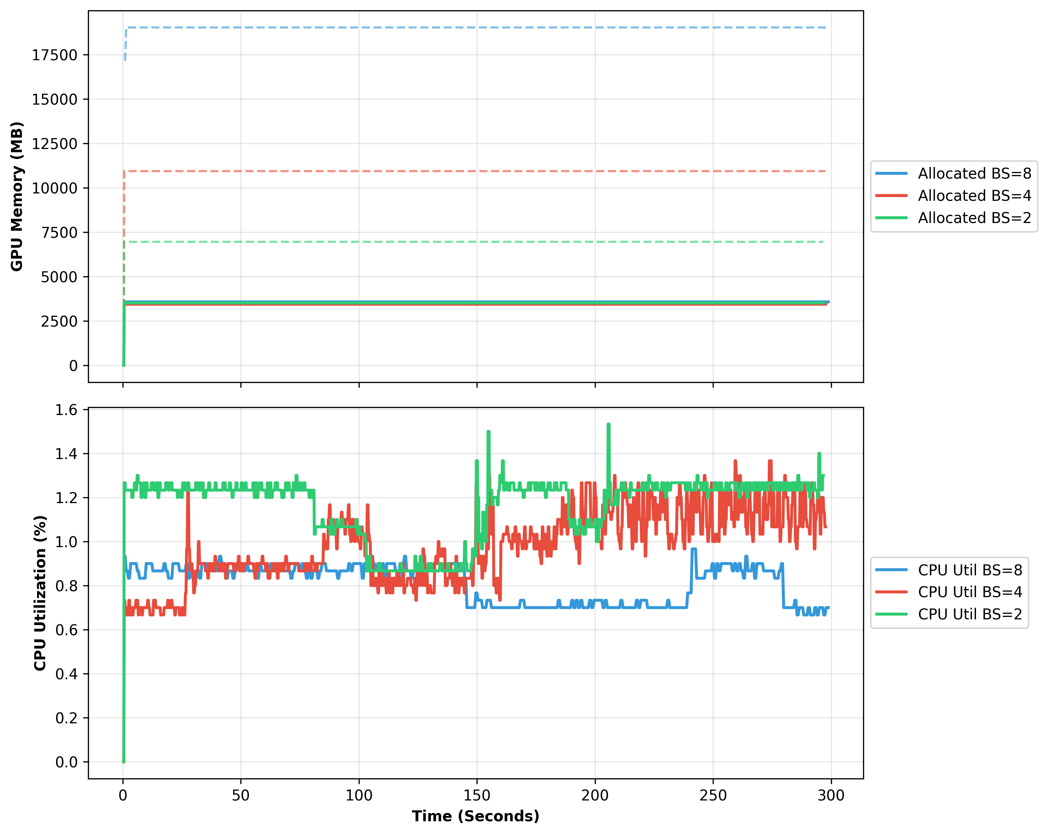
CPU Dispatching & "Idle" GPUs
The psutil Quirk: cpu_percent() averages across all 192 node cores (~1.5% = 4 saturated logical cores).
BS=2 Step Time: 138ms
Kernel Dispatches: > 7 per sec
Result: CPU orchestration bottlenecks the GPU pipeline.

Slide 11
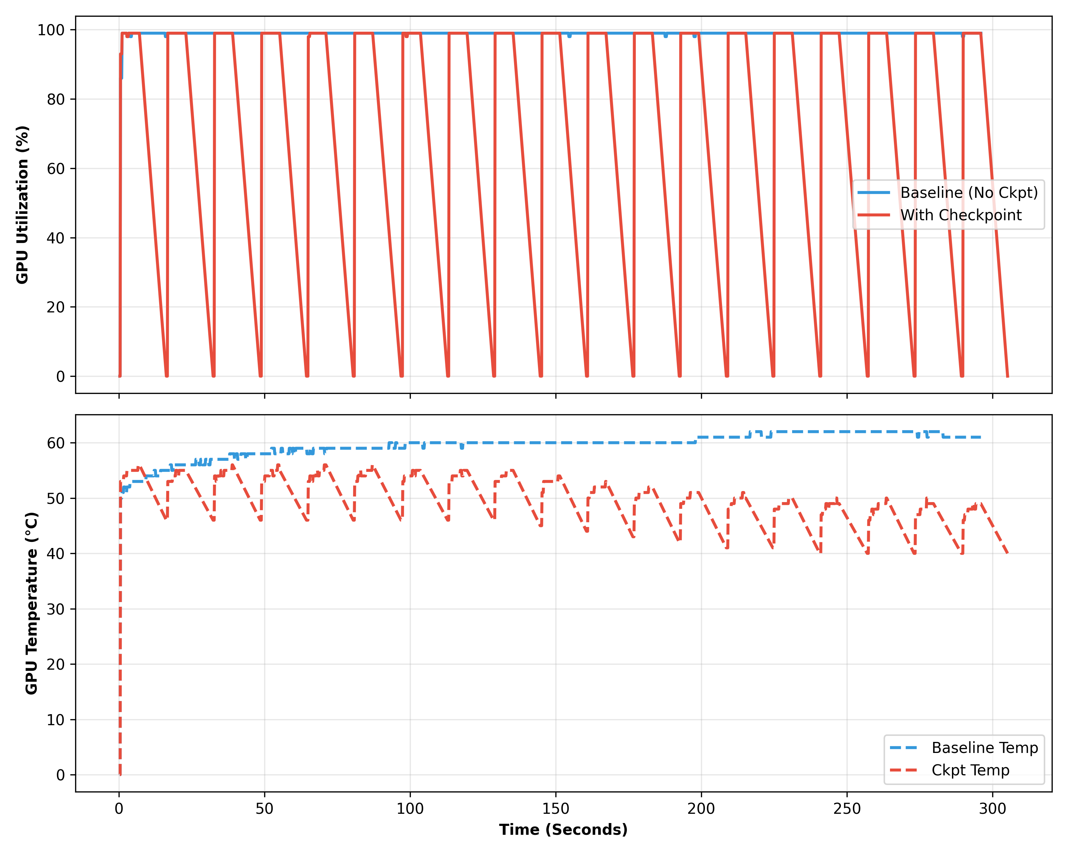
Unmasking I/O Bottlenecks
Forced Checkpoints (891MB) crash GPU utilization to 0% and drop temps from 64°C to 49°C.

Slide 12
Conclusion & Takeaways
Maximize batches to the physical VRAM ceiling.
Small batches waste energy on O(1) Optimizer updates.
High-frequency kernel dispatching causes CPU-induced GPU micro-stalls.
I/O stalls completely starve compute logic.
Questions?

